Slide 1
MEMORY LANE GAME
Gottam Sneha Latha Mary | FSJ0220A006

Slide 2
About The Project
The memory game is a basic matching game to test the player's memory. In a deck of paired cards, the player needs to match each pair to win the game.
If you're unfamiliar with the game, the rules are very simple; flip over two hidden cards at a time to locate the ones that match! The game board consists of 20 cards arranged randomly in a grid. The deck is made up of ten different pairs of cards, each with different characters on one side.
Each turn: A player flips one card over to reveal its underlying character The player then turns over a second card, trying to find the corresponding card with the same character If the cards match, both cards stay flipped over If the cards do not match, both cards are returned to their initial hidden state The game ends once all cards have been correctly matched.

Slide 3
Why This Project
The memorizing and matching cards interested me
Concepts that we learned can be implemented in this game

Slide 4
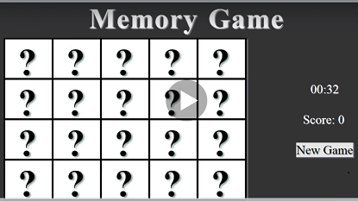
The Project

Slide 5
Concepts Used To Implement This Project
1.HTML
2 CSS
3 JAVA SCRIPT

Slide 6
The Challenges Faced
01
02
Flipping of the cards. How to make the flipping of the cards happen
Randomizing images

Slide 7

Thank You

